Slide 1
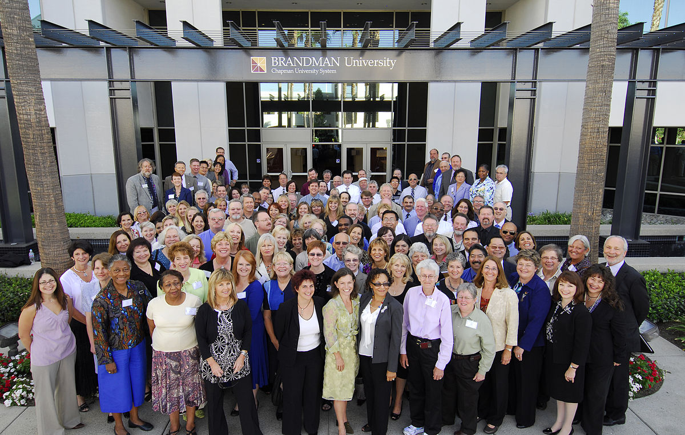
Unit 2
STAFFING AND LEADING

Slide 2

STAFFING
According to McFarland,
"Staffing is the function by which managers build an organisation through the recruitment, selection, and development of individuals as capable employees".

Slide 3
PROCESS OF STAFFING
Estimating Manpower Requirements
Training and Development of Staff
Promotion and Transfer
Recruitment and selection of staff
Remuneration
Orientation of staff
Performance Evaluation

Slide 4

Human Resource Planning
Human Resource Planning (HRP) is the process of forecasting the future human resource requirements of the organization and determining as to how the existing human resource capacity of the organization can be utilized to fulfill these requirements.

Slide 5

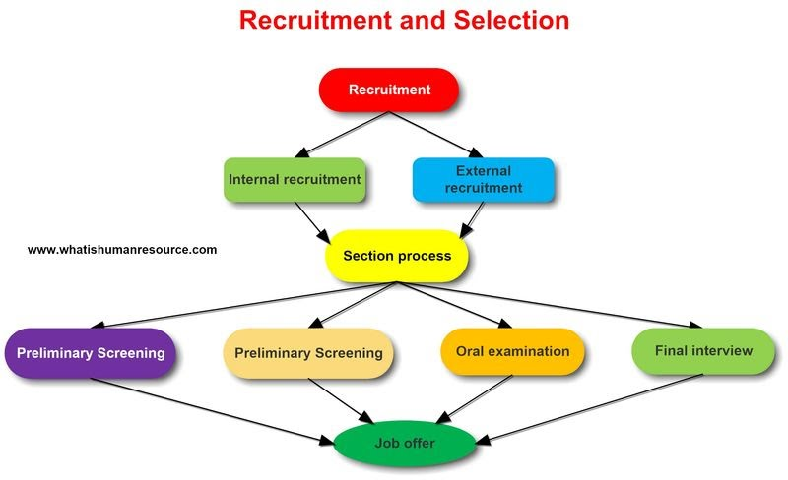

Slide 6


Training is teaching, or developing in oneself or others, any skills and knowledge that relate to specific useful competencies. Training has specific goals of improving one’s capability, capacity , productivity and performance.
In business, training is the investment of resources in the employees of a company so they are better equipped to perform their job.
Training

Slide 7


Benefits of Training
Increased job satisfaction and morale among employees
Increased employee motivation
Increased efficiencies in processes, resulting in financial gain
Increased capacity to adopt new technologies and methods
Increased innovation in strategies and products
Reduced employee turnover
Enhanced company image, e.g., building a reputation as a “great place to work”
Risk management, e.g. training about sexual harassment, diversity training

Slide 8

On-the-job training
Off-the-job training
Types of Training

Slide 9

A PERFORMANCE APPRAISAL (PA) or performance evaluation is a systematic and periodic process that assesses an individual employee’s job performance and productivity, in relation to certain pre-established criteria and organizational objectives.
Other aspects of individual employees are considered as well, such as organizational citizenship behavior, accomplishments, potential for future improvement, strengths, and weaknesses.
Performance Appraisals

Slide 10
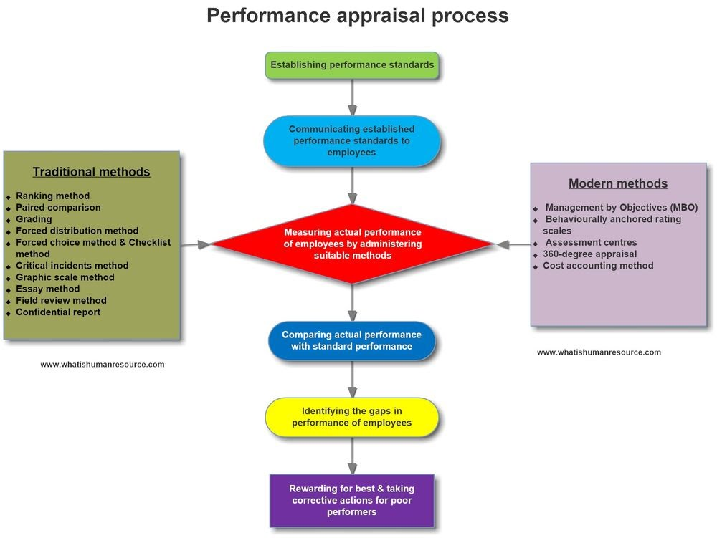
Performance Appraisal

Slide 11
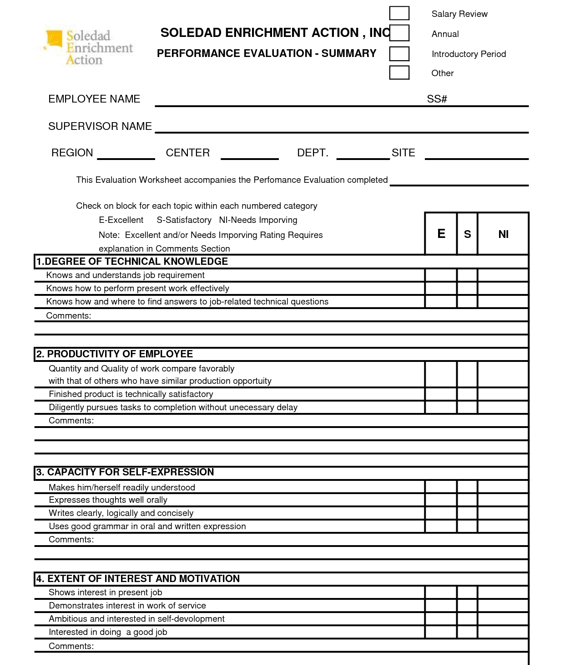
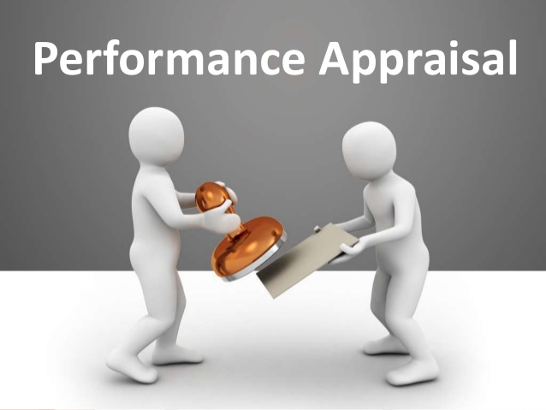

Slide 12
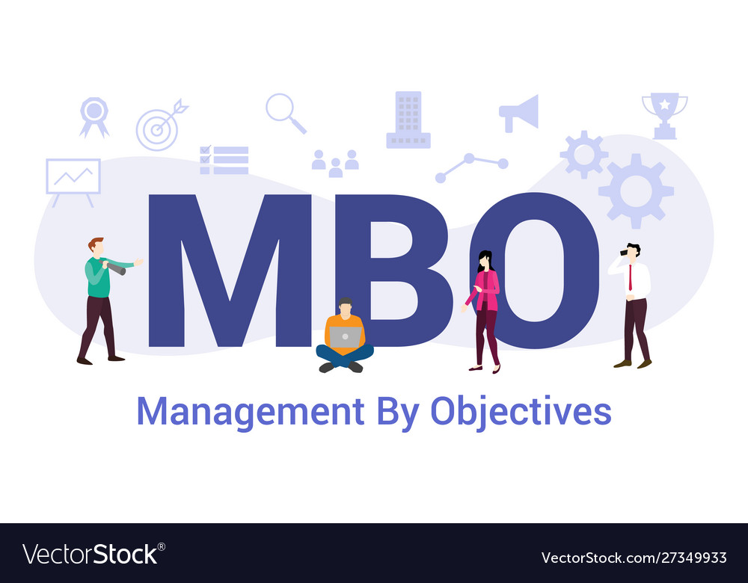
Management by Objectives (MBO) is a strategic approach to enhance the performance of an organization. It is a process where the goals of the organization are defined and conveyed by the management to the members of the organization.

Slide 13
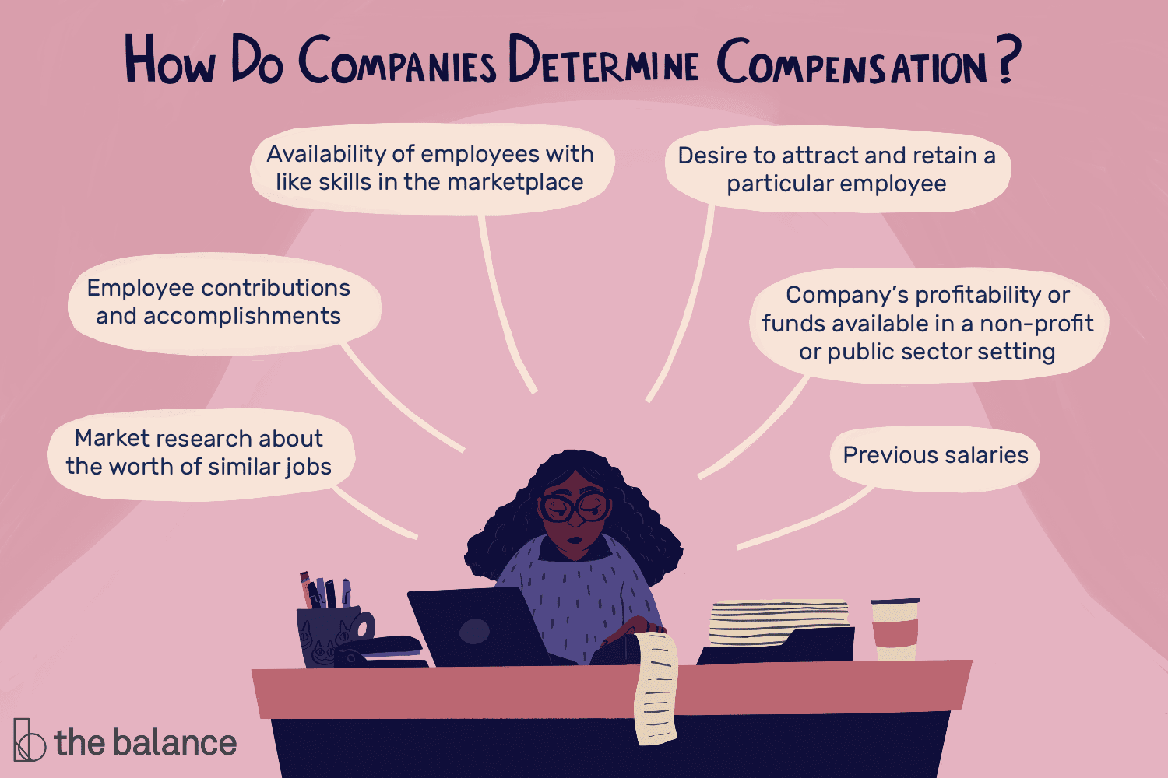

Slide 14
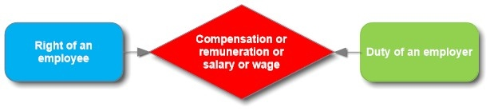
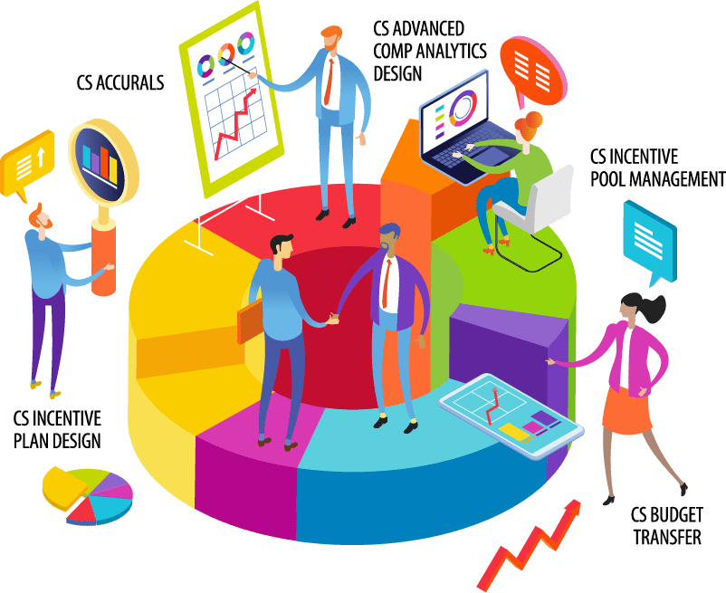
COMPENSATION

Slide 15

Salary
Wage Systems
Hybrid Wage Systems
Straight Commission
Salary plus commission
Salary plus bonus
Benefits
Forms of Employee Financial Compensation

Slide 16

Welfare, Healthy And Safety Measures
Employee Welfare
Employee Healthy Measures
Employee Safety

Slide 17
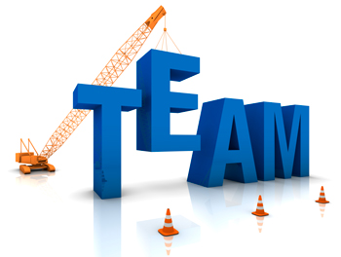
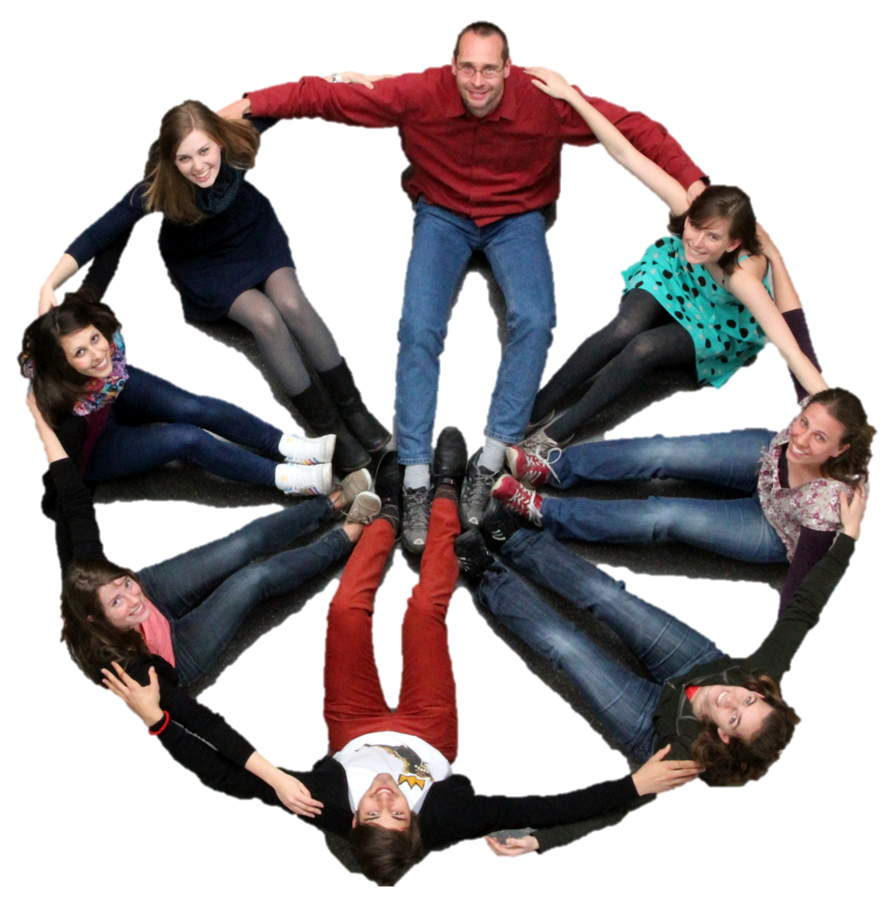
Teams are defined by the purpose the members wish to accomplish, their structure, culture, and environment.
A self managed work team is defined as a team that takes the responsibility to learn how to manage themselves, using shared leadership, structured decision making, and attend formal weekly meetings as part of their structure.

Slide 18


Effectiveness of Teams
The team has a common focus, including clear and understandable goals, plans of action, and ways to measure success.
Roles and responsibilities are clearly defined for each team member.
Each member has clearly defined expectations of other members.
The team fully utilizes its resources—both internal and external.
Members value each other's differences in healthy and productive ways.
Each member is able to give, receive, and elicit necessary feedback.
The team members manage their meetings in a productive way.
The team is able to reach goals by achieving the necessary results.

Slide 19
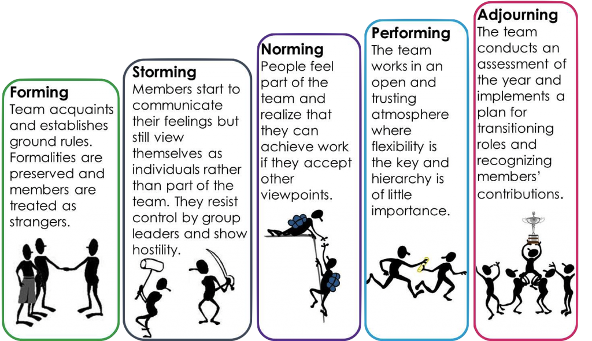
Stages of Team Development

Slide 20

Measure Team Performance
Measure Interaction
Address Conflict
Align Decisions
Create Accountability

